Slide 1


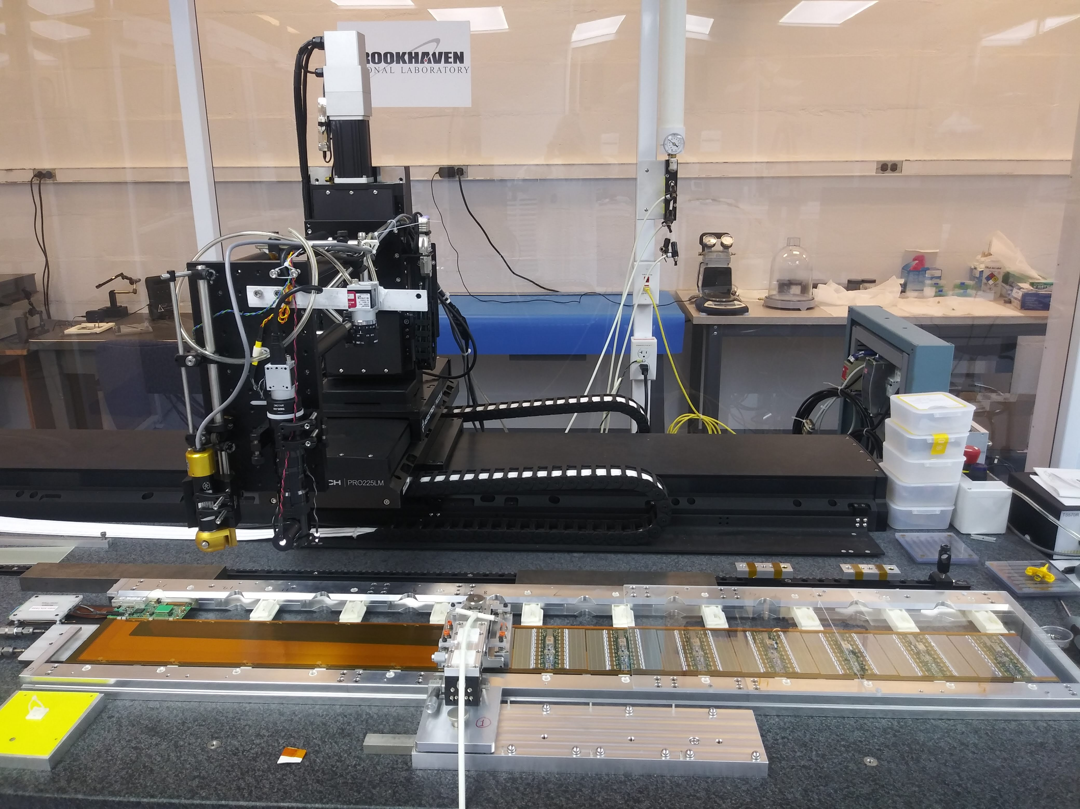
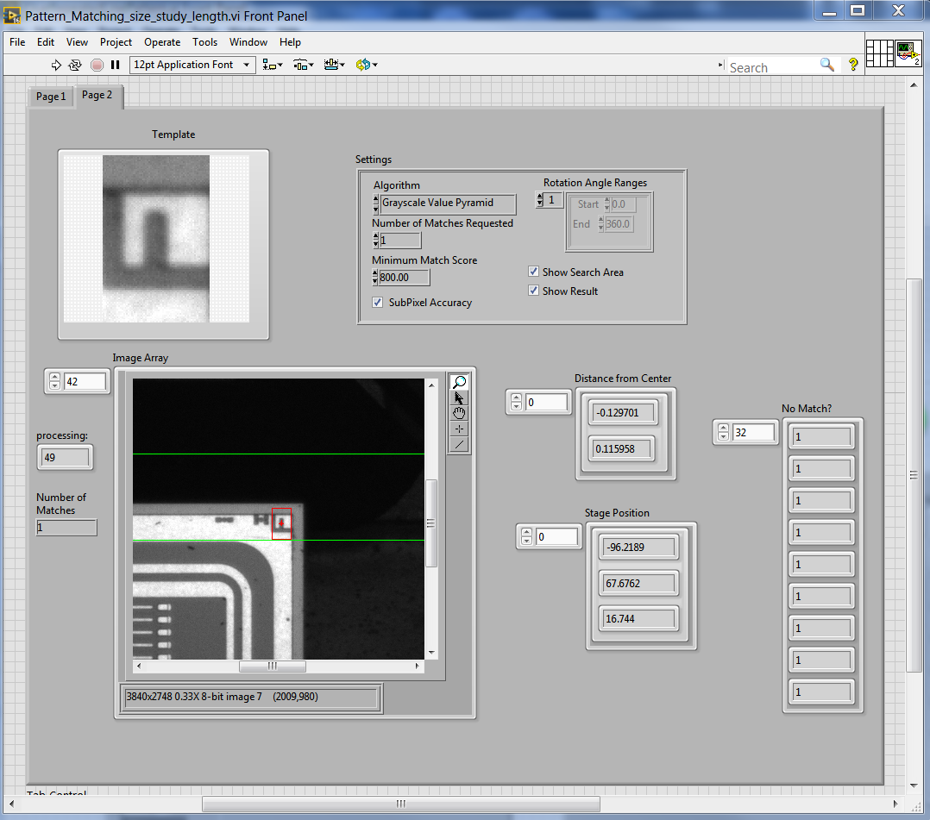
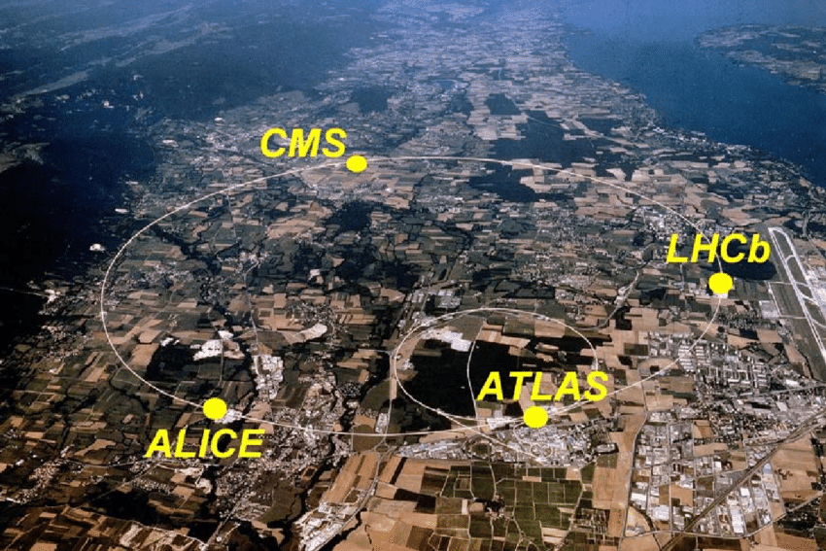
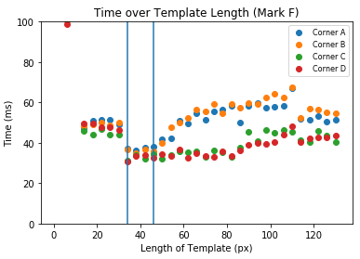
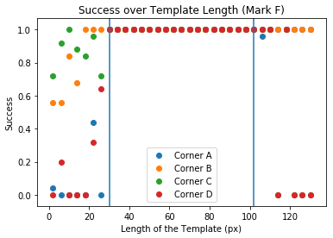
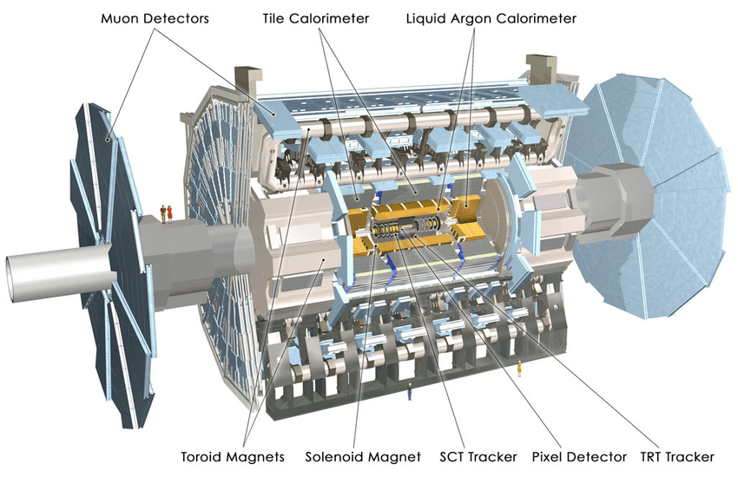
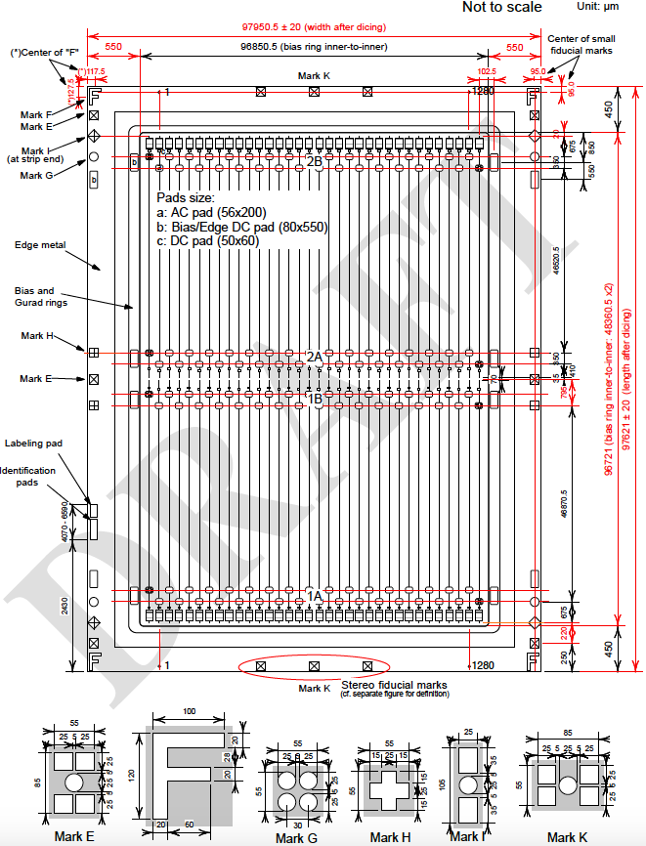
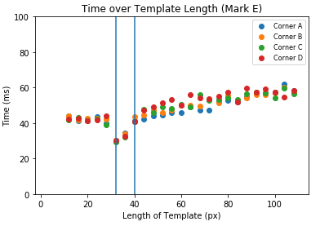
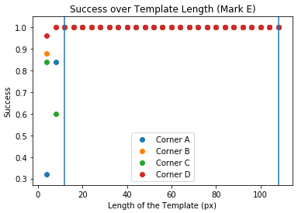
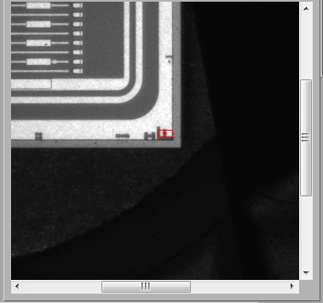
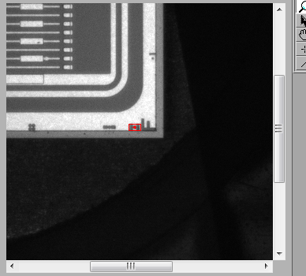
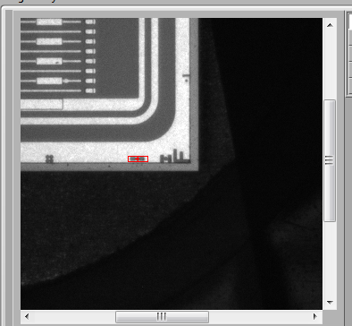
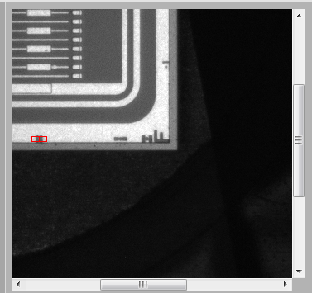
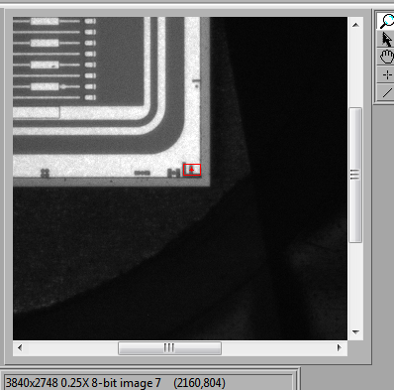
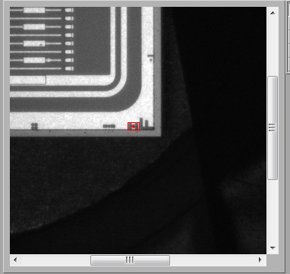
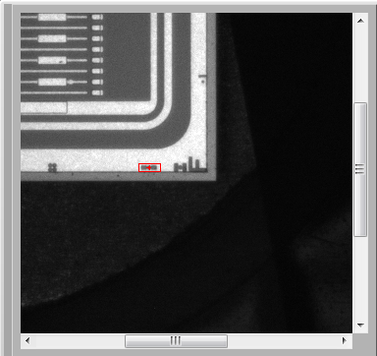
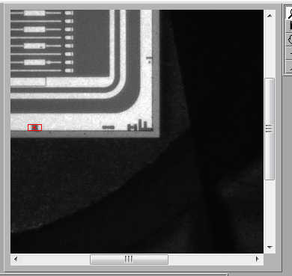
Optimizing Pattern Matching on Silicon Sensors for the Assembly of the ATLAS Experiment ITk Detector
Iria Wang, Gabriella Sciolla
Department of Physics, Brandeis University; ATLAS Experiment
Introduction
Methods
The Large Hadron Collider (LHC) at CERN in Geneva, Switzerland is the largest and most powerful particle collider in the world.
Protons at nearly the speed of light collide at four points, where experiments detect the particles resulting from the collision.
The largest experiment is ATLAS. Major objectives include the search for the Higgs Boson and Dark Matter.
In 2026, the LHC and its experiments are to be upgraded to increase the number of collisions per second by x10. Faster and more precise detectors will be needed to keep up with the LHC.
Variables:
Independent
Template Size
Minimum Match Score (MMS)
Rotation Angle Range (RAR)
Dependent
Resolution – Standard Deviation
Accuracy – Mean
Time to Pattern Match
Tested: Marks F, E, I, and G, on two different sensors
Developed a program that:
Takes pictures of the sensor¹
Cuts templates of varying heights²
Pattern matches with these templates on the sensor pictures¹
Analyzes the efficiency of templates²
¹using Python
²using LabVIEW
Figure 1: LHC accelerator and experiments.
Template
Figure 7: The module assembly robot at BNL
Figure 8: Pattern Matching Mark F in the upper right corner of the sensor.
Results
Conclusions
Context and Objectives
Analysis of Mark F and Mark E
Figure 9: Analysis of Marks F and E. “Success” is defined as the fraction of pattern match positions within 2 μm of the expected. Marks I and G are similar to Mark E.
Pattern matching is most efficient with 800 MMS and no RAR. For each mark, these is a range of template sizes that maximize accuracy and efficiency.
Starting August 2019, the templates I selected will be used in the assembly of the ITk. They will ensure accuracy and efficiency when finding sensor positions, reducing the uncertainty in the pattern matching procedure.
The majority of this project involves developing software to define the optimal template used for pattern matching. Pattern matching is used throughout the ITk assembly and testing process. My software will be reused to find the ideal template in other parts of the ITk project.
Figure 2: The ATLAS experiment.
Figure 3: The ATLAS inner tracker (ITk).
Template Length: Graphs
Mark F – 100% Success for templates with a height 30-100 pixels
Mark E, I, G – 100% Success for template height >15 pixels
Among those with 100% Success, shorter templates pattern match faster
Figure 4: An ITk stave, consisting of a stave core and 14 modules glued to each side. Each module has a silicon sensor and read-out electronics.
Ideal Templates
Figure 5: Layout of an ATLAS17LS sensor. Note Fiducial Marks E, F, I and G.
Figure 6: Reconstructed image of a collision in ATLAS.
MMS/RAR Test Results:
<< 800 MMS likely to match incorrectly
>> 800 MMS likely to not find a match
Using RAR function increases the time by 4x
Repeatability: Same results were obtained testing on different sensors
Pattern Matching with the Ideal Templates
Acknowledgements
 | Mark F | Mark E | Mark I | Mark G
Min. Ideal length | 68x34 pixels | 62x32 pixels | 88x24 pixels | 74x26 pixels
Max. Ideal length | 68x46 pixels | 62x40 pixels | 88x32 pixels | 74x34 pixels
This work was supported by Provost’s Undergraduate Research Fund and the Schiff Undergraduate Fellows Program. Thank you to Professor Gabriella Sciolla and the other students in the Sciolla Group who advised me throughout this project.
High-energy collisions result in an explosion of fundamental particles. To precisely reconstruct the trajectory of each particle, sensors must be glued onto the stave with a tolerance of 50 μm. To achieve this goal, image pattern matching in LabVIEW finds the Fiducial Mark positions.
In 2019, a new design of the silicon sensor was adopted and the accuracy and the timing of the pattern matching had to be optimized.
Contact Information
Email: iriawang@brandeis.edu

